Slide 1

Task Management Web Application – TodoApp
TodoApp is a web-based task management application developed as a final year capstone project by undergraduate students of B.Tech in Computer Science and Engineering at SRM University – AP.
Presented-by
Ankush Adhikari
by Ashok Aryal
Jangala Sai Aditya
Mohamed Youssouf Keita
Guided by
Ms. K. Kavitha Rani
SRM University – AP.

Slide 2

Introduction & Problem Statement
Motivation
Problem
Teams need efficient tools to manage and organize daily tasks.
Traditional task apps lack customization, accessibility, and API support.
Solution
Responsive, API-powered app to simplify planning and enhance productivity.

Slide 3

Objectives
User-centric Interface
Real-time Features
Add, complete, and delete tasks effortlessly.
Filtering and progress tracking with live updates.
API Integration
Responsive Design
Provide RESTful APIs for seamless external connections.
Consistent UI/UX across all devices.

Slide 4
Technology Stack
Backend & Database
Frontend & Templating
Configuration
Python with Flask
HTML5, CSS3, Bootstrap 5
.env file
SQLite with SQLAlchemy ORM
Jinja2 templates
config.py for app settings

Slide 5
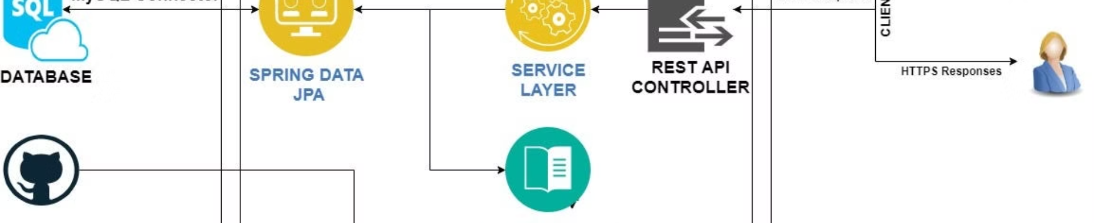
System Architecture
1
Models
2
Views
Use SQLAlchemy ORM for database interactions.
Render pages with Jinja2 templates.
3
Controllers
4
APIs
Manage routes and logic with Flask decorators.
Expose RESTful endpoints for external apps.

Slide 6
Key Functionalities
Task Operations
Filtering & Analytics
API Support
Add new tasks
Filter by all, pending, and completed
Comprehensive CRUD and analytics endpoints.
Complete and delete tasks
Progress bar and statistical views

Slide 7

UI Design
Clean and Modern
Responsive Layout
Custom Styling
Built with Bootstrap 5 showcasing a minimalist style.
Optimized for all screen sizes and devices.
Distinct task priority colors and hover effects.

Slide 8
Security & API Integration
Security Measures
API Features
.env for secure configuration
JSON-compatible APIs
Session secret keys and debug control
Compatible with Postman and external apps

Slide 9
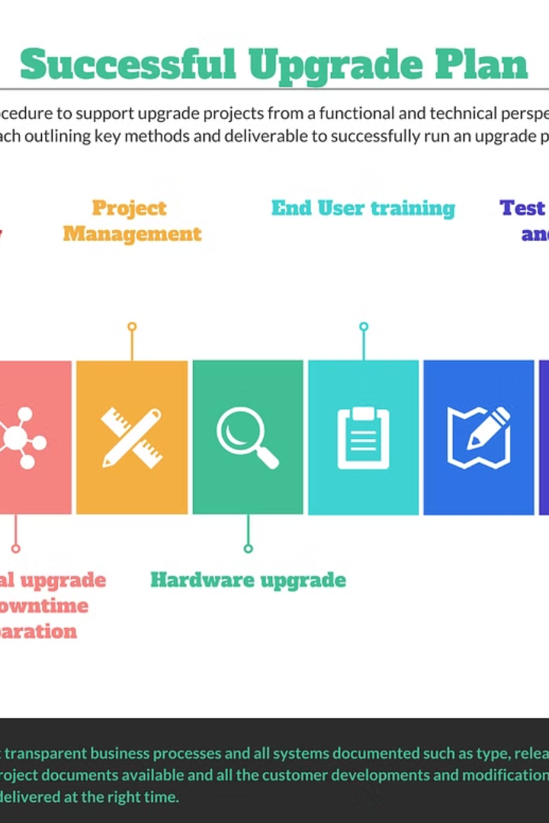
Results & Future Enhancements
Current Achievements
Responsive user interface
Functional REST API
Modular, scalable architecture
Future Additions
User authentication
Reminders and notifications
Dark mode and modern frontend

Slide 10
Conclusion & References
Conclusion
References
The app is lightweight, powerful, and scalable for future growth.
Flask
SQLAlchemy
Bootstrap 5
Jinja2
Python-dotenv

